Slide 1
Turing Machine

Slide 2
What is Turing machine?
A Turing machine is a mathematical model of computation that defines an abstract machine, which manipulates symbols on a strip of tape according to a table of rules.
It is a generalized machine which can accept all the type of languages i.e. regular , context free, context sensitive, recursive and recursive enumerable languages .
There are two purposes for a Turing machine: deciding formal languages and solving mathematical functions.

Slide 3
Model of Turing Machine
a | b | c | c | a | b | a | a | a | b
L
R
R/W head
Input Tape
q Finite State Control

Slide 4
Mathematical Definition of Turing Machine (TM)
A Turing machine is described by a 7-tuple
M=(Q, Σ, Γ, δ, q₀, B, F) where,
Q is the finite set of states,
Σ ⊆ Γ is the set of input symbols
Γ is the set of tape symbols,
q₀ ∈ Q is the initial state,
B ∈ Γ is a blank symbol
F is the set of final states, and
δ is a transition function which is defined as following:-
δ: Q×Γ → Q×Γ×{L, R}
where,
L represents left direction and R represents right direction.

Slide 5
Instantaneous Description(ID)
An instantaneous description of TM is a string of the following form:-
α q β
Where, α, β ∈ Γ*, q ∈ Q.
αβ denotes the whole contents of the tape.
q is a current state.
R/W head of machine will be at the leftmost symbol of β.
Initial ID will be q₀w . where w ∈ Σ*

Slide 6

Move relation
This relation exist between two consecutives ID’s. It is dented by .
Consider an ID of a TM at any instant is
a₁a₂a₃………..a_{i-1}qa_{i}a_{i+1}……….a_{n}.
(1) If δ(q, a_{i}) = (p, y, R) then move of machine will be
a₁a₂a₃………..a_{i-1}qa_{i}a_{i+1}……….a_{n} a₁a₂a₃………..a_{i-1} ypa_{i+1}……….a_{n}
(2) If δ(q, a_{i}) = (p, y, L) then move of machine will be
a₁a₂a₃………..a_{i-1}qa_{i}a_{i+1}……….a_{n} a₁a₂a₃………..pa_{i-1} ya_{i+1}……….a_{n}

Slide 7
Language accepted by TM
The language accepted by Turing machine M is defined as following:-
L(M) = { w ! q₀w * α p β where w ∈ Σ* ,
p ∈ F and α, β ∈ Γ* and machine halts on the final state.}

Slide 8
Representation of TM
Two representations are used for TM.
(1) By transition table (2) By transition diagram
By transition table
δ | Tape symbols
States | 0 | 1 | x | y | B
q₀ | (q₁, x, R) |  |  | (q₃, y, R)
q₁ | (q₁, 0, R) | (q₂, y, L) |  | (q₁, y, R)
q₂ | (q₂, 0, L) |  | (q₀, x, R) | (q₂, y, L)
q₃ |  |  |  | (q₃, y, R) | (q₄, B, R)
q₄

Slide 9
Turing Machine
Part-2

Slide 10
Representation of TM(continue)
By transition diagram
(0, 0 ,L)
(y, y, L)
(0, 0 ,R)
(y, y, R)
(0, x ,R)
(1, y ,L)
q₀
q₁
q₂
(y, y, R)
(x, x ,R)
(B, B ,R)
q₃
q₄
(y, y, R)

Slide 11
Processing or working of TM
Ex. Check the acceptability of following strings
(1) 0011 (2) 011 (3) 00101
by the TM in the previous example.
Solution:
(1) For string 0011
q₀0011 ⊢ xq₁011 ⊢ x0q₁11 ⊢ xq₂0y1 ⊢ q₂x0y1 ⊢ xq₀0y1 ⊢ xxq₁y1 ⊢ xxyq₁1 ⊢ xxq₂yy ⊢ xq₂xyy ⊢ xxq₀yy ⊢ xxyq₃y ⊢ xxyyq₃B ⊢ xxyyBq₄B (machine halts at final state)
Since machine halts at final state, therefore this string is accepted by TM.

Slide 12
Processing or working of TM(continue)
(2) For string 011
q₀011 ⊢ xq₁11 ⊢ q₂xy1 ⊢ xq₀y1 ⊢ xyq₃1 (machine halts at non-final state)
Since machine halts at non-final state, therefore this string is not accepted by TM.
(3) For string 00101
q₀00101 ⊢ xq₁0101 ⊢ x0q₁101 ⊢ xq₂0y01 ⊢ q₂x0y01 ⊢ xq₀0y01 ⊢ xxq₁y01 ⊢ xxyq₁01 ⊢ xxy0q₁1 ⊢ xxyq₂0y ⊢ xxq₂y0y ⊢ xq₂xy0y ⊢ xxq₀y0y ⊢ xxyq₃0y (machine halts at non-final state)
Since machine halts at non-final state, therefore this string is not accepted by TM.

Slide 13
Construction of TM
In this section, we shall see how TM’s can be constructed.
Ex. Construct TM for the following languages:-
L = { 0^{m}1^{n} ! m, n ≥ 1}
L= the set of all strings of 0 and 1 which contain 001 as a substring.
L= the set of all strings of 0 and 1 ending with 101.
L= the set of strings of a and b which contains at least one a’s and exactly two b’s.

Slide 14
Ex. L = { 0^{m}1^{n} ! m, n ≥ 1}
Solution:
Procedure: First check given language is regular or not. If language is regular then first construct DFA for that language. After, convert it into TM.
Since this language is regular, Therefore the TM for this language will be
(1,1,R)
(0, 0 ,R)
(0, 0 ,R)
(1, 1 ,R)
q₀
q₁
q₂

Slide 15
Ex. L= the set of all strings of 0 and 1 which contain 001 as a substring.
Solution:
Since this language is regular, therefore the TM for this language is
(1, 1, R)
(0, 0, R)
(1, 1 , R)
(0, 0, R)
(1, 1, R)
(0, 0 , R)
(0, 0 , R)
(1, 1, R)
q₀
q₁
q₂
q₃

Slide 16
Turing Machine
Part-3

Slide 17
Ex. Construct Turing machine for the language L = { 0^{n}1^{n} ! n ≥ 1 }.
Solution:
To construct Turing for a language, first we have to identify the pattern of strings belongs in to L. Some strings are 01, 0011, 000111 etc.
Now, you have to think, how machine move from initial ID to final ID.
Procedure: Initially machine starts at the initial state q₀. machine scan the tape string. If the current tape symbol is 0, then machine change its state, replace the current input symbol 0 by another tape symbol and also the head of machine move in the right direction.
Machine move in the right direction until 1 appears in the tape. As soon as 1 appears in the tape, machine replaces 1 by some another tape symbol, return to back i.e. move in the left direction and change its state.

Slide 18
L = { 0^{n}1^{n} ! n ≥ 1 }
Machine move in the left direction till leftmost 0 appears in tape. As soon as, machine be reached at leftmost 0, its state becomes q₀.
we repeat the whole process till any 0 in the tape. As soon as, all 0’s are deleted from tape, we check number of 1’s in tape. If there is any 1’s in the tape, then machine reject the string otherwise machine may accept the string.
Therefore, the TM corresponding to this language will be
M=( {q₀,q₁,q₂,q₃, q₄}, {0, 1}, {0, 1, x, y, B}, q₀, B, {q₄})

Slide 19
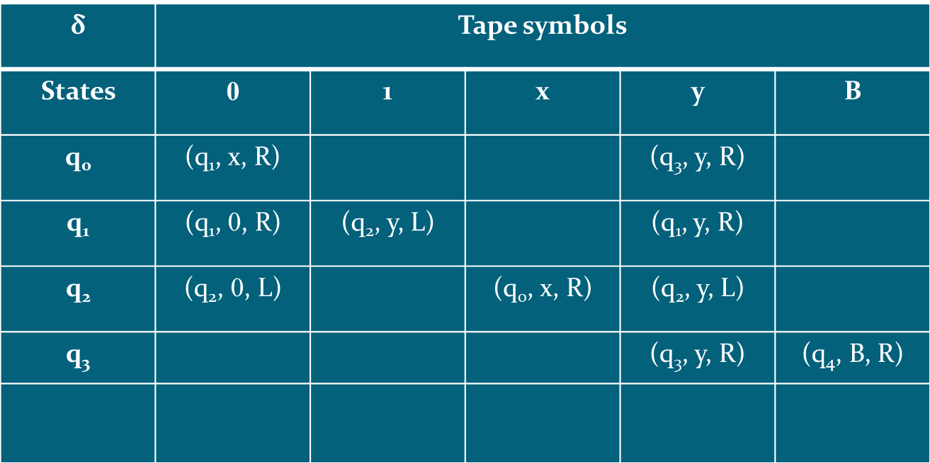
L = { 0^{n}1^{n} ! n ≥ 1 }
Transition table is
q₄

Slide 20
L = { 0^{n}1^{n} ! n ≥ 1 }
Transition diagram is
(0, 0 ,L)
(y, y, L)
(0, 0 ,R)
(y, y, R)
(0, x ,R)
(1, y ,L)
q₀
q₁
q₂
(y, y, R)
(x, x ,R)
(B, B ,R)
q₃
q₄
(y, y, R)

Slide 21
Processing and Verification of TM
Acceptance
Consider string w = 0011 .
q₀0011 ⊢ xq₁011 ⊢ x0q₁11 ⊢ xq₂0y1 ⊢ q₂x0y1 ⊢ xq₀0y1 ⊢ xxq₁y1 ⊢ xxyq₁1 ⊢ xxq₂yy ⊢ xq₂xyy ⊢ xxq₀yy ⊢ xxyq₃y ⊢ xxyyq₃B ⊢ xxyyBq₄B (machine halts at final state)
Since machine halts at final state, therefore this string is accepted by TM.
Rejection
Consider string w = 011 .
q₀011 ⊢ xq₁11 ⊢ q₂xy1 ⊢ xq₀y1 ⊢ xyq₃1 (machine halts at non-final state)
Since machine halts at non-final state, therefore this string is not accepted by TM.

Slide 22
Ex. Construct Turing machine for the language L = { 0^{n}1^{n}2^{n}! n ≥ 1 }.
Solution:
The TM corresponding to this language is
(0, 0 ,L)
(y, y, L)
(1, 1, L)
(z, z, L)
(0, 0 ,R)
(y, y, R)
(1, 1,R)
(z, z, R)
(0, x ,R)
(1, y ,R)
(2, z ,L)
q₀
q₁
q₂
q₃
(y, y, R)
(x, x ,R)
(B, B ,R)
q₄
q₅
(z, z, R)
(y, y, R)

Slide 23
Processing and Verification of TM
Acceptance
Consider string w = 001122 .
q₀001122 ⊢ xq₁01122 ⊢ x0q₁1122 ⊢ x0yq₂122 ⊢ x0y1q₂22 ⊢ x0yq₃1z2 ⊢ x0q₃y1z2 ⊢ xq₃0y1z2 ⊢ q₃x0y1z2 ⊢ xq₀0y1z2 ⊢ xxq₁y1z2 ⊢ xxyq₁1z2 ⊢ xxyyq₂z2 ⊢ xxyyzq₂2 ⊢ xxyyq₃zz ⊢ xxyq₃yzz ⊢ xxq₃yyzz ⊢ xq₃xyyzz ⊢ xxq₀yyzz ⊢ xxyq₄yzz ⊢ xxyyq₄zz ⊢ xxyyzq₄z ⊢ xxyyzzq₄B ⊢ xxyyzzBq₅B
(machine halts at final state)
Since machine halts at final state, therefore this string is accepted by TM.

Slide 24
Rejection
Consider string w = 00112 .
q₀00112 ⊢ xq₁0112 ⊢ x0q₁112 ⊢ x0yq₂12 ⊢ x0y1q₂2 ⊢ x0yq₃1z ⊢ x0q₃y1z ⊢ xq₃0yq₁1z ⊢ q₃x0y1z ⊢ xq₀0y1z ⊢ xxq₁y1z ⊢ xxyq₁1z ⊢ xxyyq₂z ⊢ xxyyzq₂B
(machine halts at non-final state)
Since machine halts at non-final state, therefore this string is not accepted by TM.

Slide 25
Turing Machine
Part-4

Slide 26
Ex. Construct TM to accept the language L = { wcw^{R} ! w ∈ {a, b}* }
Solution:
Some strings of this set are c, aca, bcb, abcba, bacab, aabcbaa etc.
Clearly all these strings are palindrome. That is, first symbol and last symbol are same. Similarly, second symbol and second last symbol are same , and so on.
Procedure: TM is constructed in following steps. Let q₀ is the initial state.
If the first input symbol is a, then remove it and change its state to q₁. After this, machine move to the last input symbol, if last input symbol is a, then machine remove it and back to first input symbol of string. This process continue.
If the first input symbol is b, then remove it and change its state to q₅. After this, machine move to the last input symbol, if last input symbol is b, then machine remove it and back to first input symbol of string. This process continue.

Slide 27
L = { wcw^{R} ! w ∈ {a, b}* }
Transition diagram of TM is
(a, a ,R)
(b, b, R)
(a, a ,R)
(b, b, R)
(a, a ,L)
(b, b, L)
(c, c, L)
(c, c ,R)
(B, B, L)
q₁
q₂
q₃
(a, B ,R)
(a, B, L)
(B, B, R)
q₀
q₄
(a, a ,R)
(b, b, R)
(a, a ,R)
(b, b, R)
(b, B ,R)
(c, c ,R)
q₅
q₆
q₇
(b, B, L)
(c, c ,R)
(B, B, L)
(B, B ,R)
q₈
q₉

Slide 28
Processing and Verification of TM
Acceptance
Consider string w = aabcbaa .
q₀aabcbaa ⊢ Bq₁abcbaa ⊢ Baq₁bcbaa ⊢ Babq₁cbaa ⊢ Babcq₂baa ⊢ Babcbq₂aa ⊢ Babcbaq₂a ⊢ Babcbaaq₂B ⊢ Babcbaq₃aB ⊢ Babcbq₄aB ⊢ Babcq₄baB ⊢ Babq₄cbaB ⊢ Baq₄bcbaB ⊢ Bq₄abcbaB ⊢ q₄BabcbaB ⊢ Bq₀abcbaB ⊢ BBq₁bcbaB ⊢ BBbq₁cbaB ⊢ BBbcq₂baB ⊢ BBbcbq₂aB ⊢ BBbcbaq₂B ⊢ BBbcbq₃aB ⊢ BBbcq₄bBB ⊢ BBbq₄cbBB ⊢ BBq₄bcbBB ⊢ Bq₄BbcbBB ⊢ BBq₀bcbBB ⊢ BBBq₅cbBB ⊢ BBBcq₆bBB ⊢ BBBcbq₆BB ⊢ BBBcq₇bBB ⊢ BBBq₄cBBB ⊢ BBq₄BcBBB ⊢ BBBq₀cBBB ⊢ BBBcq₈BBB⊢ BBBcBq₉BB (machine halts at final state)
Since machine halts at final state, therefore this string is accepted by TM.

Slide 29
Rejection
Consider string w = abcaa .
q₀abcaa ⊢ Bq₁bcaa ⊢ Bq₁bcaa ⊢ Bbq₁caa ⊢ Bbcq₂aa ⊢ Bbcaq₂a ⊢ Bbcaaq₂B ⊢ Bbcaq₃aB ⊢ Bbcq₄aB ⊢ Bbq₄caB ⊢ Bq₄bcaB ⊢ q₄BbcaB ⊢ Bq₀bcaB ⊢ BBq₅caB ⊢ BBcq₆aB ⊢ BBcaq₆B ⊢ BBcq₇aB (machine halts at non-final state)
Since machine halts at non-final state, therefore this string is not accepted by TM.

Slide 30
Ex. Construct TM to accept the language L = { ww^{R} ! w ∈ {a, b}* }
Transition diagram of TM is
(a, a ,R)
(b, b, R)
(B, B, L)
(a, a ,L)
(b, b, L)
q₁
q₂
(a, B ,R)
(a, B, L)
(B, B, R)
q₃
q₀
(a, a ,R)
(b, b, R)
(b, B ,R)
q₄
q₅
(b, B, L)
(B, B ,R)
(B, B, L)
q₆

Slide 31
Processing and Verification of TM
Acceptance
Consider string w = abba.
q₀abba ⊢ Bq₁bba ⊢ Bbq₁ba ⊢ Bbbq₁a ⊢ Bbbaq₁B⊢ Bbbq₂aB ⊢ Bbq₃bBB ⊢ Bq₃bbBB ⊢ q₃BbbBB ⊢ Bq₀bbBB ⊢ BBq₄bBB ⊢ BBbq₄BB ⊢ BBq₅bBB ⊢ Bq₃BBBB ⊢ BBq₀BBB ⊢ BBBq₆BB
(machine halts at final state)
Since machine halts at final state, therefore this string is accepted by TM.
Rejection
Consider string w = abaa .
q₀abaa ⊢ Bq₁baa ⊢ Bbq₁aa ⊢ Bbaq₁a ⊢ Bbaaq₁B ⊢ Bbaq₂aB ⊢ Bbq₃aBB ⊢ Bq₃baBB ⊢ q₃BbaBB ⊢ Bq₀baBB ⊢ BBq₄aBB ⊢ BBaq₄BB ⊢ BBq₅aBB (machine halts at non-final state)
Since machine halts at non-final state, therefore this string is not accepted by TM.

Slide 32
Some additional problems
Construct TM for the following languages:-
L = { a^{n+2}b^{n} ! n ≥ 1}
L = { a^{n}b^{n}c^{m} ! m, n ≥ 0}
L = {a^{n}b^{n}c^{n} ! n ≥ 1}

Slide 33
Turing Machine
Part-5

Slide 34
Turing computable function
Def. A function f : N^{n} →N is said to be Turing computable function if there exist a Turing machine which compute this function.
Here N^{n} = N×N×N……………………………×N(upto n times)
Note:
1) In the designing of Turing machine, we use unary number to represent a number. Here we use the unary number as a string of 1’s.
Ex. 4 = 1111, 3 = 111 and so on.
2) If the function has multiple arguments, then we separate the arguments by 0.

Slide 35
Ex. Construct Turing machine for the following function
f(n) = n+2 n ∈ N
f(m,n) = m+n m, n ∈ N
Solution:
In this function, if input is 1111 then output will be 111111.
i.e. q₀1111 ⊢* q_{f}111111
TM for this function will be
Computation by this machine
q₀1111 ⊢ q₀B1111 ⊢ q₁B11111 ⊢ q₂B111111 (machine halt at final state)
(1, 1 ,L)
(B, 1 ,L)
(B, 1 ,L)
q₀
q₁
q₂

Slide 36
(2) f(m,n) = m+n m, n ∈ N
Solution:
In this function if the input is 110111 then output will be 11111.
TM for this function will be
Computation by this machine
q₀110111⊢ 1q₀10111 ⊢ 11q₀0111 ⊢ 111q₁111 ⊢ 1111q₁11 ⊢ 11111q₁1 ⊢ 111111q₁B ⊢ 11111q₂1 B⊢ 11111Bq₃B (machine halt at final state)
(1, 1 ,R)
(1, 1 ,R)
(0, 1 ,R)
(B, B ,L)
(1, B ,R)
q₀
q₁
q₂
q₃

Slide 37
Ex. Show that following function is Turing computable:-
f(n) = 3*n n ≥ 1
Solution:
A function is said to be Turing computable if there exist a TM for this.
Therefore, we shall construct TM for this function.
In this function, if the input is 2 then output will be 6. That is if input is 11 then output will be 111111.
First, we shall show that how string 11 is converted into 111111. After this, we construct Turing machine for this.
Suppose initial state is q₀.
q₀11 ⊢yq₁1 ⊢y1q₁B⊢y1Bq₂B ⊢y1B1q₃B ⊢y1B11q₄B ⊢y1B1q₅11 ⊢y1Bq₅111 ⊢y1q₅B111 ⊢yq₅1B111 ⊢q₅y1B111 ⊢yq₀1B111 ⊢yyq₁B111 ⊢yyBq₂111⊢yyB1q₂11⊢yyB11q₂1⊢yyB111q₂B ⊢yyB1111q₃B ⊢yyB11111q₄B ⊢yyB1111q₅11B ⊢yyB111q₅111B ⊢yyB11q₅1111B ⊢yyB1q₅11111B ⊢yyBq₅111111B ⊢yyq₅B111111B ⊢yq₅yB111111B ⊢yyq₀B111111B ⊢yyBq₆111111B

Slide 38
Therefore, the Turing machine corresponding above function is constructed as following:-
(1, 1 ,L)
(B, B, L)
(1, 1 ,R)
(1, y ,R)
(B, B ,R)
(B, 1 ,R)
(B, 1 ,R)
(B, 1 ,L)
q₀
q₁
q₂
q₃
q₄
q₅
(y, y ,R)
(B, B ,R)
q₆
q₆

Slide 39
Turing Machine
Part-6

Slide 40
Ex. Show that following function is Turing computable:-
f(m, n) = m-n m ≥ n
= 0 otherwise
Solution: Clearly this function is proper subtraction function.
We have to find TM corresponding to this function.
There are two cases of this function.
Case-1: If m ≥ n then value of the function is m-n. i.e. if m= 6 and n=4 then value = 2.
Case-2: If m < n then value of the function is 0. i.e. if m= 4 and n=6 then value = 0.
Before constructing TM for this function, first we process the input and develop rules through which machine move from initial ID to final ID.

Slide 41
Case-1: when m ≥ n.
q₀1111011 ⊢ 1q₀111011 ⊢ 11q₀11011 ⊢ 111q₀1011 ⊢ 1111q₀011 ⊢11110q₁11 ⊢1111q₂0y1 ⊢ 111q₂10y1 ⊢ 111yq₀0y1⊢ 111y0q₁y1⊢ 111y0yq₁1 ⊢111y0q₂yy ⊢ 111yq₂0yy ⊢ 111q₂y0yy⊢ 11q₂1y0yy⊢ 11yq₀y0yy⊢ 11yyq₀0yy
⊢ 11yy0q₁yy⊢ 11yy0yq₁y⊢ 11yy0yyq₁B⊢ 11yy0yq₃yB
(machine halts at final state)
Case-2: when m < n.
q₀1101111 ⊢* yy0yyq₁11 ⊢ yy0yq₂yy1 ⊢* q₂Byy0yyy1 ⊢ Bq₄yy0yyy1 ⊢* Byy0yyyq₄1 ⊢ Byy0yyyyq₄B⊢ Byy0yyyq₃yB
(machine halts at final state)

Slide 42
Therefore, the TM corresponding this function will be constructed as following:-
(y, y , L)
(0, 0, L)
(y, y , R)
(0, 0, R)
(1, y, R)
(1, 1 ,R)
(y, y, R)
(y, y , R)
(0, 0, R)
(1, y , L)
(B, B ,R)
q₀
q₁
q₂
q₄
(1, y , R)
(B, B ,L)
(B, B ,L)
q₃
q₃

Slide 43
Ex. Construct Turing machine for the following function f(m,n) = m*n m, n ∈ N
Solution: This function multiply two numbers.
If inputs are 2 and 3 then output will be 6.
Processing:
q₀110111 ⊢xq₁10111 ⊢ x1q₁0111 ⊢ x10q₂111 ⊢ x10yq₂11 ⊢
x10yyq₂1 ⊢ x10yyyq₂B ⊢ x10yyq₃yB ⊢ x10yy1q₄B ⊢ x10yy1B q₅B⊢ x10yy1q₆B1⊢ x10yyq₃1B1⊢ x10yq₃y1B1
⊢ x10y1q₄1B1⊢ x10y11q₄B1⊢ x10y11Bq₅1⊢ x10y11B1q₅B⊢ x10y11Bq₆11⊢ x10y11q₆B11 ⊢ x10y1q₃1B11 ⊢ x10yq₃11B11⊢ x10q₃y11B11⊢ x101q₄11B11⊢ x1011q₄1B11⊢ x10111q₄B11⊢ x10111Bq₅11⊢ x10111B1q₅1⊢ x10111B11q₅B⊢ x10111B1q₆11⊢ x10111Bq₆111⊢ x10111q₆B111⊢ x1011q₃1B111⊢ x101q₃11B111⊢ x10q₃111B111 ⊢ x1q₃0111B111 ⊢ xq₃10111B111 ⊢ q₃x10111B111⊢ xq₀10111B111 ⊢ *xxq₀0111B111111 ⊢xxBq₇111B111111 ⊢xxBBq₇11B111111 ⊢xxBBBq₇1B111111 ⊢xxBBBBq₇B111111 ⊢xxBBBBBq₈111111 (machine halts at final state)

Slide 44
Therefore, the TM corresponding this function will be constructed as following:-
(1, 1 ,L)
(0, 0, L)
(1, 1 ,R)
(1, 1 ,R)
(1, y ,R)
(1, 1 ,R)
(1,x, R)
(0, 0, R)
(B, B, L)
(y, 1 ,R)
(B, B ,R)
q₀
q₁
q₂
q₃
q₄
q₅
(B, 1, L)
(0,B, R)
(x, x, R)
(B, B, L)
q₆
(B, B ,R)
q₀
q₇
q₈
(1, B ,R)
(1, 1, L)

Slide 45
Turing Machine
Part-7

Slide 46
Variations or types of TM
Non-deterministic Turing Machine(TM)
Multi-tape Turing Machine(TM)
Multi-head Turing Machine(TM)
Multi-directional Turing Machine(TM)

Slide 47
Non-deterministic Turing Machine(TM)
A non-deterministic TM is a Turing machine which, like nondeterministic finite automata, at any state it is in and for the tape symbol it is reading, can take any action selecting from a set of specified actions rather than taking one definite predetermined action.
Even in the same situation it may take different actions at different times.
It differs from deterministic TM only by transition function.
The transition function of non-deterministic TM is defined as following:-
δ: Q×Γ → 2^{Q×Γ×{L, R}}

Slide 48
Multi-tape Turing Machine(TM)
Model of TM
a | b | c | c | a | b | a | a | a | b
R/W head
a | b | c | c | a | b | a | a | a | b
R/W head
a | b | c | c | a | b | a | a | a | b
R/W head
q Finite State Control

Slide 49
Multi-tape Turing Machine(TM)
This type of machine consists of n number of tapes. Since number of tapes is n, therefore the number of heads will also be n.
Transition function will be
δ: Q×Γ^{n} → Q×Γ^{n}×{L, R}^{n}
Where
Γ^{n} = Γ× Γ× Γ×……………….. × Γ(upto n times)
{L, R}^{n} = {L, R}× {L, R}× {L, R}×……………….. × {L, R} (upto n times)

Slide 50
Multi-head Turing Machine(TM)
Model of TM
Tape
a | b | c | c | a | b | a | a | a | b
R/W head
R/W head
R/W head
q Finite State Control

Slide 51
Multi-head Turing Machine(TM)
This type of machine consists of one tape with n heads.
Transition function will be
δ: Q×Γ^{n} → Q×Γ^{n}×{L, R}^{n}
Where
Γ^{n} = Γ× Γ× Γ×……………….. × Γ(upto n times)
{L, R}^{n} = {L, R}× {L, R}× {L, R}×……………….. × {L, R} (upto n times)

Slide 52
Multi-dimensional Turing Machine(TM)
Tow-dimensional tape
Model of TM
 |  |  | U
 |  | L |  | R
 |  |  | D
Head
q Finite State Control

Slide 53
Multi-dimensional Turing Machine(TM)
This type of machine consists of one multi-dimensional tape with one heads.
The head of machine move in many directions.
If tape is n-dimensional then head move in 2^{n} directions.
Transition function of two-dimensional TM is defined as
δ: Q×Γ → Q×Γ×{L, R, U, D}
Where
L→ Left direction
R→ Right direction
U→ Up direction
D→ Down direction

Slide 54
Recursive and Recursive Enumerable language
Recursive language:
A language L is said to be recursive if there exists a Turing machine M which accepts all the strings w belong into L and rejects all the strings which do not belong into L.
Recursive Enumerable language:
A language L is said to be recursive enumerable if there exists a Turing machine M which accepts all the strings w belong into L and rejects or goes into an infinite loop for all the strings which do not belong into L.
w
M
Y
N
RE
w
M
R
Y

Slide 55
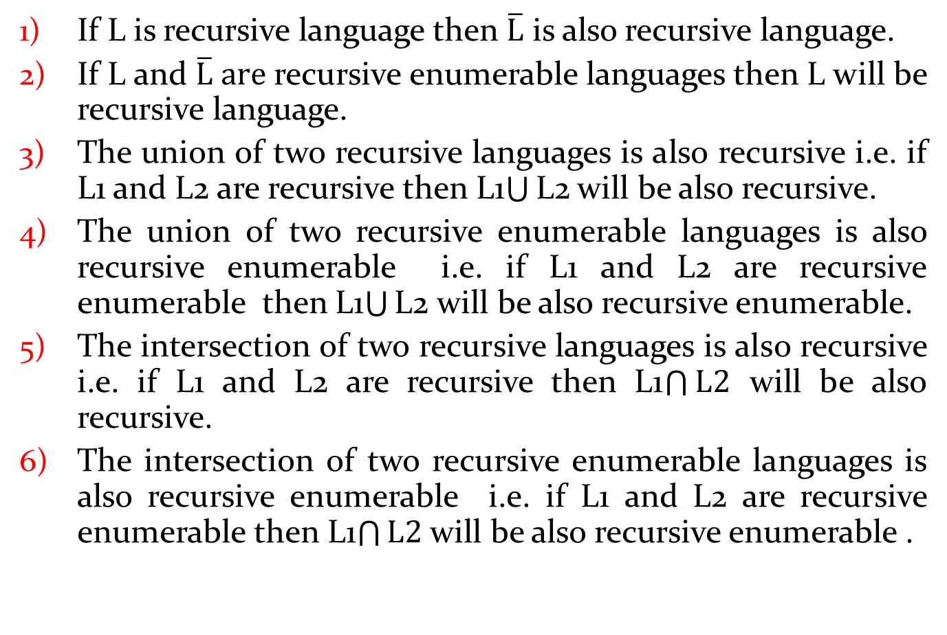
Properties of Recursive and Recursive Enumerable languages
If L is recursive language then $\overline{L}$ is also recursive language.
If L and $\overline{L} are$recursive enumerable languages then L will be recursive language.
The union of two recursive languages is also recursive i.e. if L1 and L2 are recursive then L1$\bigcup{\text{L}\text{2}}$ will be also recursive.
The union of two recursive enumerable languages is also recursive enumerable i.e. if L1 and L2 are recursive enumerable then L1$\bigcup{\text{L}\text{2}}$ will be also recursive enumerable.
The intersection of two recursive languages is also recursive i.e. if L1 and L2 are recursive then L1$\bigcap{L2}$ will be also recursive.
The intersection of two recursive enumerable languages is also recursive enumerable i.e. if L1 and L2 are recursive enumerable then L1$\bigcap{L2}$ will be also recursive enumerable .

Slide 56
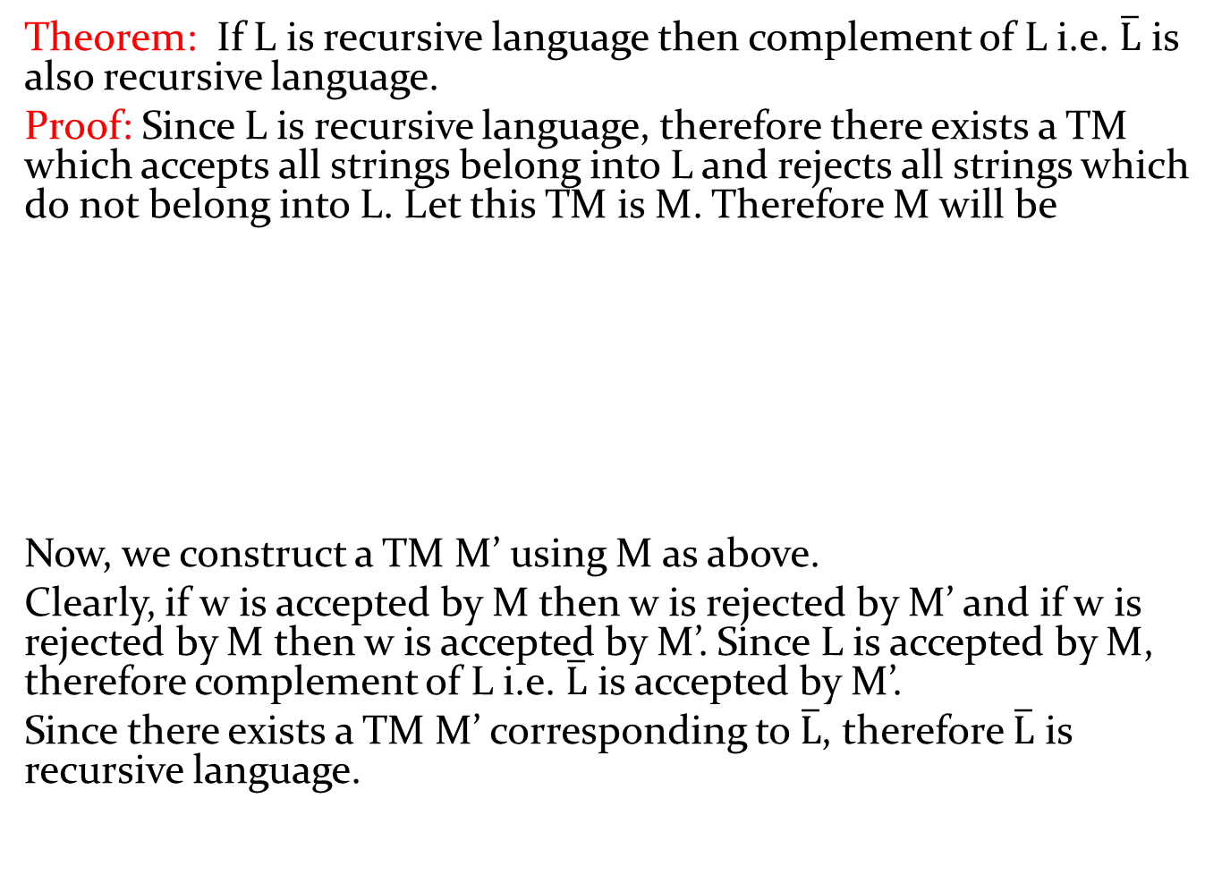
Theorem: If L is recursive language then complement of L i.e. $\overline{L}$ is also recursive language.
Proof: Since L is recursive language, therefore there exists a TM which accepts all strings belong into L and rejects all strings which do not belong into L. Let this TM is M. Therefore M will be
Now, we construct a TM M’ using M as above.
Clearly, if w is accepted by M then w is rejected by M’ and if w is rejected by M then w is accepted by M’. Since L is accepted by M, therefore complement of L i.e. $\overline{L}$ is accepted by M’.
Since there exists a TM M’ corresponding to $\overline{L}$, therefore $\overline{L}$ is recursive language.
Y
Y
M
Y
w
M
w
N
N
N
M’

Slide 57
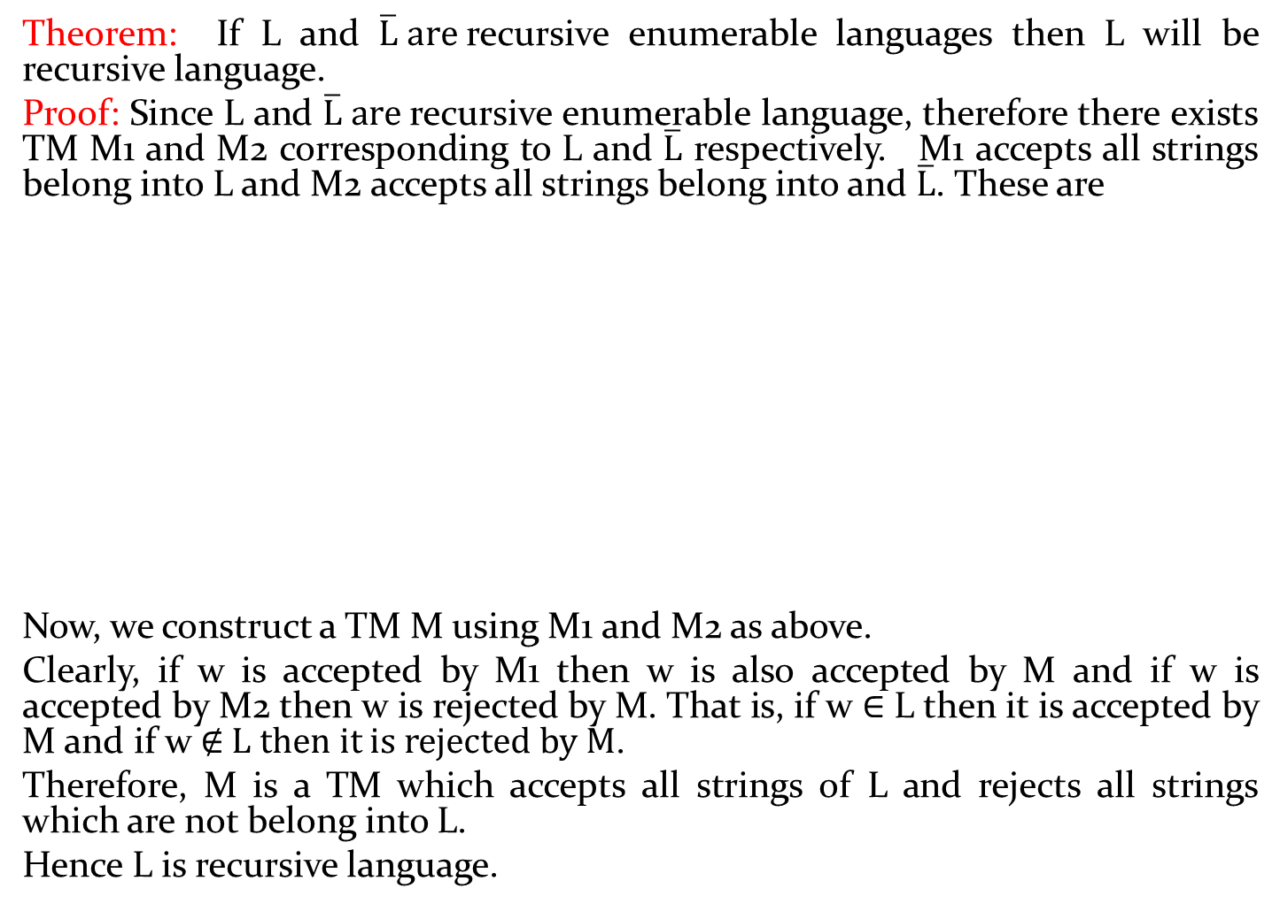
Theorem: If L and $\overline{L} are$recursive enumerable languages then L will be recursive language.
Proof: Since L and $\overline{L} are$recursive enumerable language, therefore there exists TM M1 and M2 corresponding to L and $\overline{L}$ respectively. M1 accepts all strings belong into L and M2 accepts all strings belong into and $\overline{L}$. These are
Now, we construct a TM M using M1 and M2 as above.
Clearly, if w is accepted by M1 then w is also accepted by M and if w is accepted by M2 then w is rejected by M. That is, if w ∈ L then it is accepted by M and if w ∉ L then it is rejected by M.
Therefore, M is a TM which accepts all strings of L and rejects all strings which are not belong into L.
Hence L is recursive language.
w
Y
w
Y
Y
M1
M1
w
M2
Y
Y
N
M2
M

Slide 58
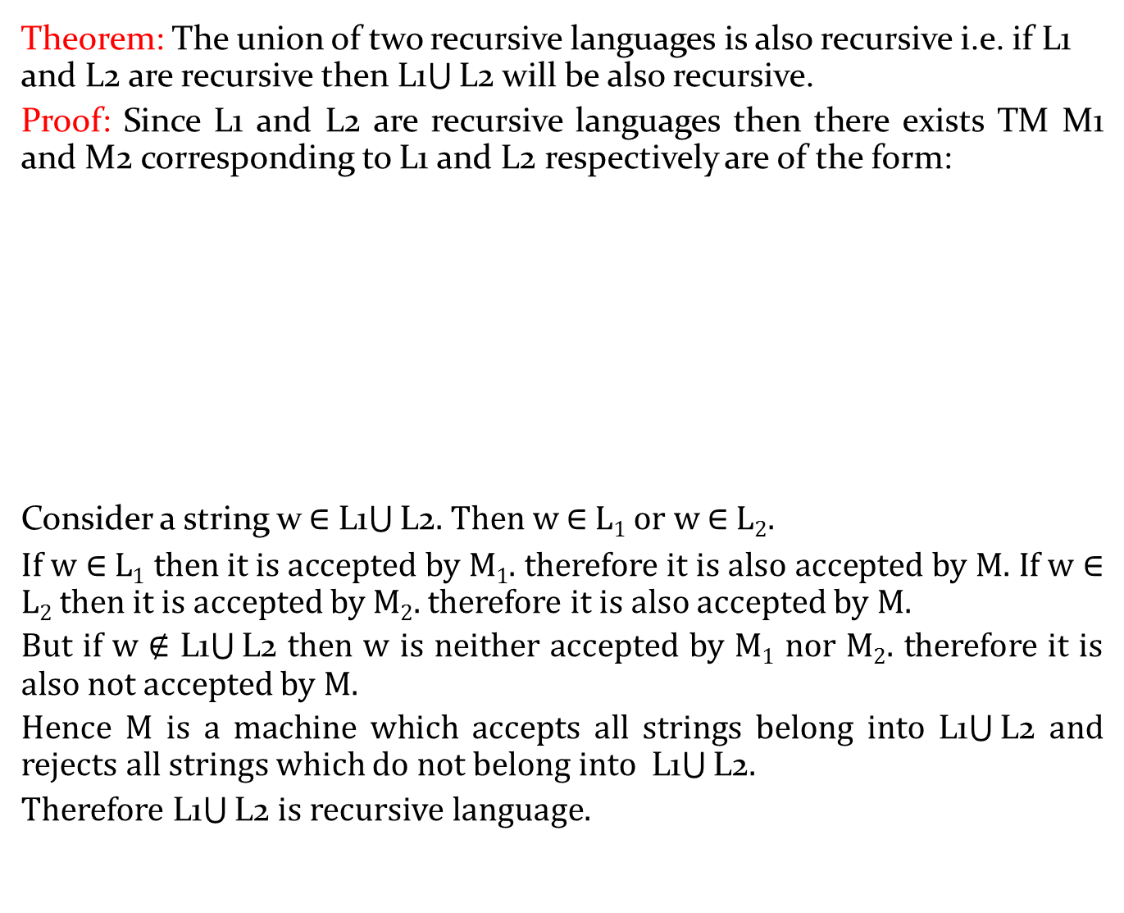
Theorem: The union of two recursive languages is also recursive i.e. if L1 and L2 are recursive then L1$\bigcup{\text{L}\text{2}}$ will be also recursive.
Proof: Since L1 and L2 are recursive languages then there exists TM M1 and M2 corresponding to L1 and L2 respectively are of the form:
Consider a string w ∈ L1$\bigcup{\text{L}\text{2}}$. Then w ∈ L₁ or w ∈ L₂.
If w ∈ L₁ then it is accepted by M₁. therefore it is also accepted by M. If w ∈ L₂ then it is accepted by M₂. therefore it is also accepted by M.
But if w ∉ L1$\bigcup{\text{L}\text{2}}$ then w is neither accepted by M₁ nor M₂. therefore it is also not accepted by M.
Hence M is a machine which accepts all strings belong into L1$\bigcup{\text{L}\text{2}}$ and rejects all strings which do not belong into L1$\bigcup{\text{L}\text{2}}$.
Therefore L1$\bigcup{\text{L}\text{2}}$ is recursive language.
E-> enable
M
w
Y
M1
Y
N
w
M1
Y
N
w
Y
Y
M2
E
N
w
M2
N
N

Slide 59
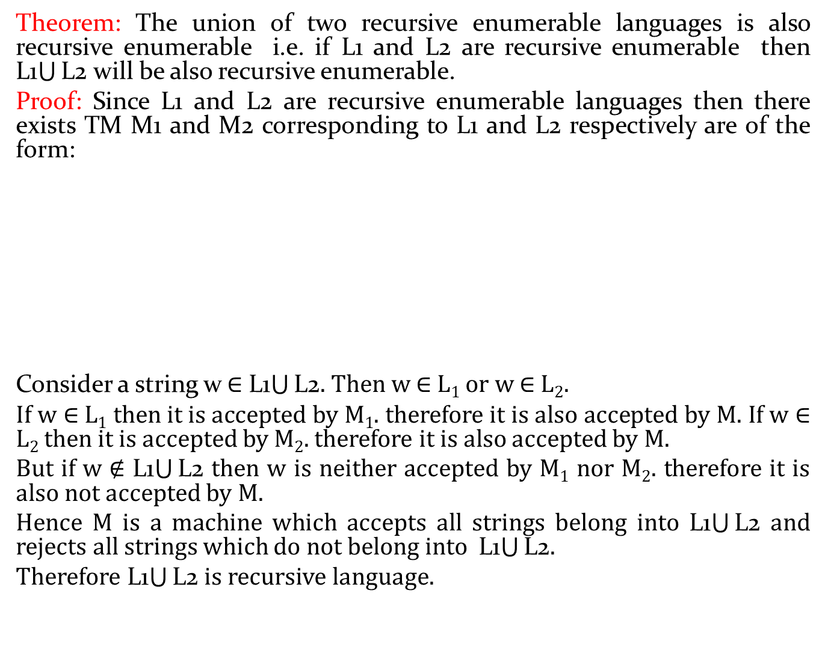
Theorem: The union of two recursive enumerable languages is also recursive enumerable i.e. if L1 and L2 are recursive enumerable then L1$\bigcup{\text{L}\text{2}}$ will be also recursive enumerable.
Proof: Since L1 and L2 are recursive enumerable languages then there exists TM M1 and M2 corresponding to L1 and L2 respectively are of the form:
Consider a string w ∈ L1$\bigcup{\text{L}\text{2}}$. Then w ∈ L₁ or w ∈ L₂.
If w ∈ L₁ then it is accepted by M₁. therefore it is also accepted by M. If w ∈ L₂ then it is accepted by M₂. therefore it is also accepted by M.
But if w ∉ L1$\bigcup{\text{L}\text{2}}$ then w is neither accepted by M₁ nor M₂. therefore it is also not accepted by M.
Hence M is a machine which accepts all strings belong into L1$\bigcup{\text{L}\text{2}}$ and rejects all strings which do not belong into L1$\bigcup{\text{L}\text{2}}$.
Therefore L1$\bigcup{\text{L}\text{2}}$ is recursive language.
M
w
M1
Y
w
Y
M1
Y
w
Y
M2
Y
M2

Slide 60
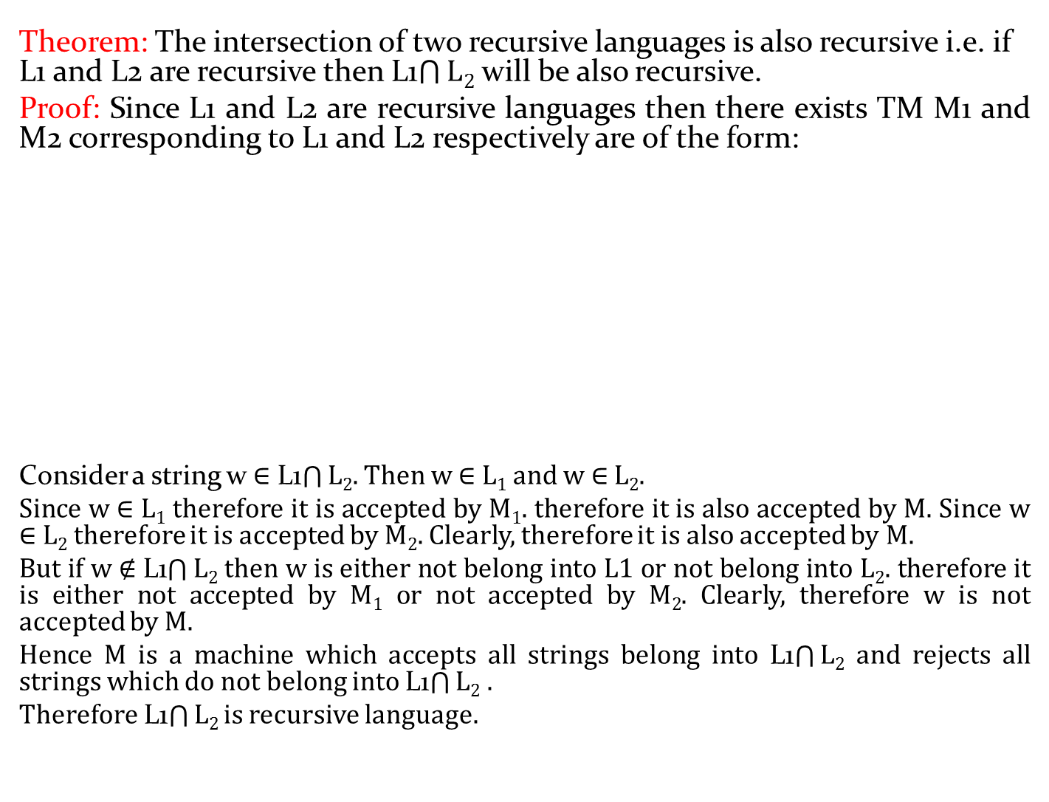
Theorem: The intersection of two recursive languages is also recursive i.e. if L1 and L2 are recursive then L1$\bigcap{L2}$ will be also recursive.
Proof: Since L1 and L2 are recursive languages then there exists TM M1 and M2 corresponding to L1 and L2 respectively are of the form:
Consider a string w ∈ L1$\bigcap{L2}$. Then w ∈ L₁ and w ∈ L₂.
Since w ∈ L₁ therefore it is accepted by M₁. therefore it is also accepted by M. Since w ∈ L₂ therefore it is accepted by M₂. Clearly, therefore it is also accepted by M.
But if w ∉ L1$\bigcap{L2}$ then w is either not belong into L1 or not belong into L₂. therefore it is either not accepted by M₁ or not accepted by M₂. Clearly, therefore w is not accepted by M.
Hence M is a machine which accepts all strings belong into L1$\bigcap{L2}$ and rejects all strings which do not belong into L1$\bigcap{L2}$ .
Therefore L1$\bigcap{L2}$ is recursive language.
E-> enable
M
w
Y
M1
Y
Y
N
w
M1
N
w
Y
Y
M2
E
N
w
M2
N
N

Slide 61
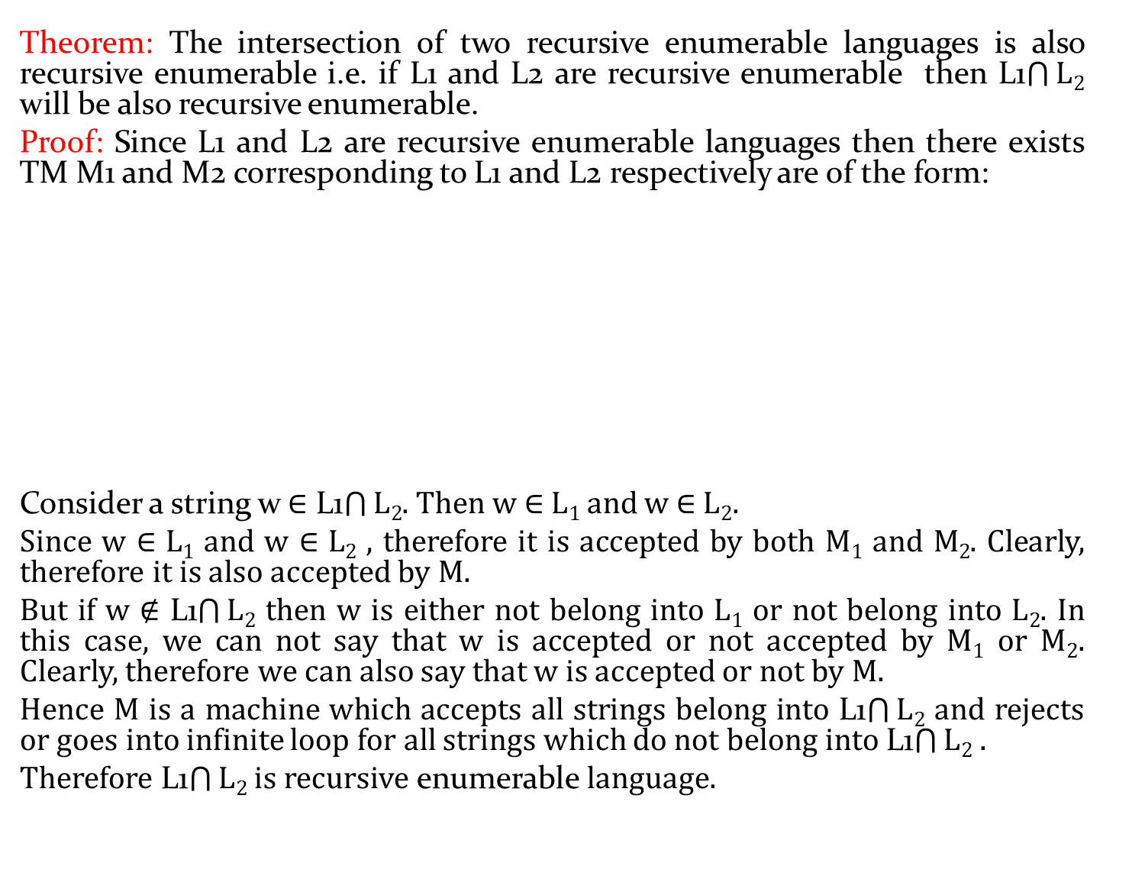
Theorem: The intersection of two recursive enumerable languages is also recursive enumerable i.e. if L1 and L2 are recursive enumerable then L1$\bigcap{L2}$ will be also recursive enumerable.
Proof: Since L1 and L2 are recursive enumerable languages then there exists TM M1 and M2 corresponding to L1 and L2 respectively are of the form:
Consider a string w ∈ L1$\bigcap{L2}$. Then w ∈ L₁ and w ∈ L₂.
Since w ∈ L₁ and w ∈ L₂ , therefore it is accepted by both M₁ and M₂. Clearly, therefore it is also accepted by M.
But if w ∉ L1$\bigcap{L2}$ then w is either not belong into L₁ or not belong into L₂. In this case, we can not say that w is accepted or not accepted by M₁ or M₂. Clearly, therefore we can also say that w is accepted or not by M.
Hence M is a machine which accepts all strings belong into L1$\bigcap{L2}$ and rejects or goes into infinite loop for all strings which do not belong into L1$\bigcap{L2}$ .
Therefore L1$\bigcap{L2}$ is recursive enumerable language.
E-> enable
M
w
M1
Y
M1
Y
w
Y
w
Y
E
M2
Y
M2
w

Slide 62
Post Correspondence Problem(PCP)
The PCP problem over an alphabet ∑ is stated as follows:−
Given the following two lists, X and Y of non-empty strings over ∑,
X = (x₁, x₂, x₃,………, x_{n})
Y = (y₁, y₂, y₃,………, y_{n})
We can say that there is a Post Correspondence Solution, if for some (i₁,i₂,………… i_{k}), where 1 ≤ i_{j} ≤ n, the condition x_{i1} x_{i2} …….x_{ik} = y_{i1} y_{i2} …….y_{ik} satisfies.

Slide 63
Ex. Find whether the lists X = (abb, aa, aaa) and
Y = (bba, aaa, aa) have a Post Correspondence Solution?
Solution:
Here,
x₂x₁x₃ = ‘aaabbaaa’
and y₂y₁y₃ = ‘aaabbaaa’
We can see that
x₂x₁x₃ = y₂y₁y₃
Hence, the solution is (2, 1,3). Another solution may be also (2, 3), (3, 2).

Slide 64
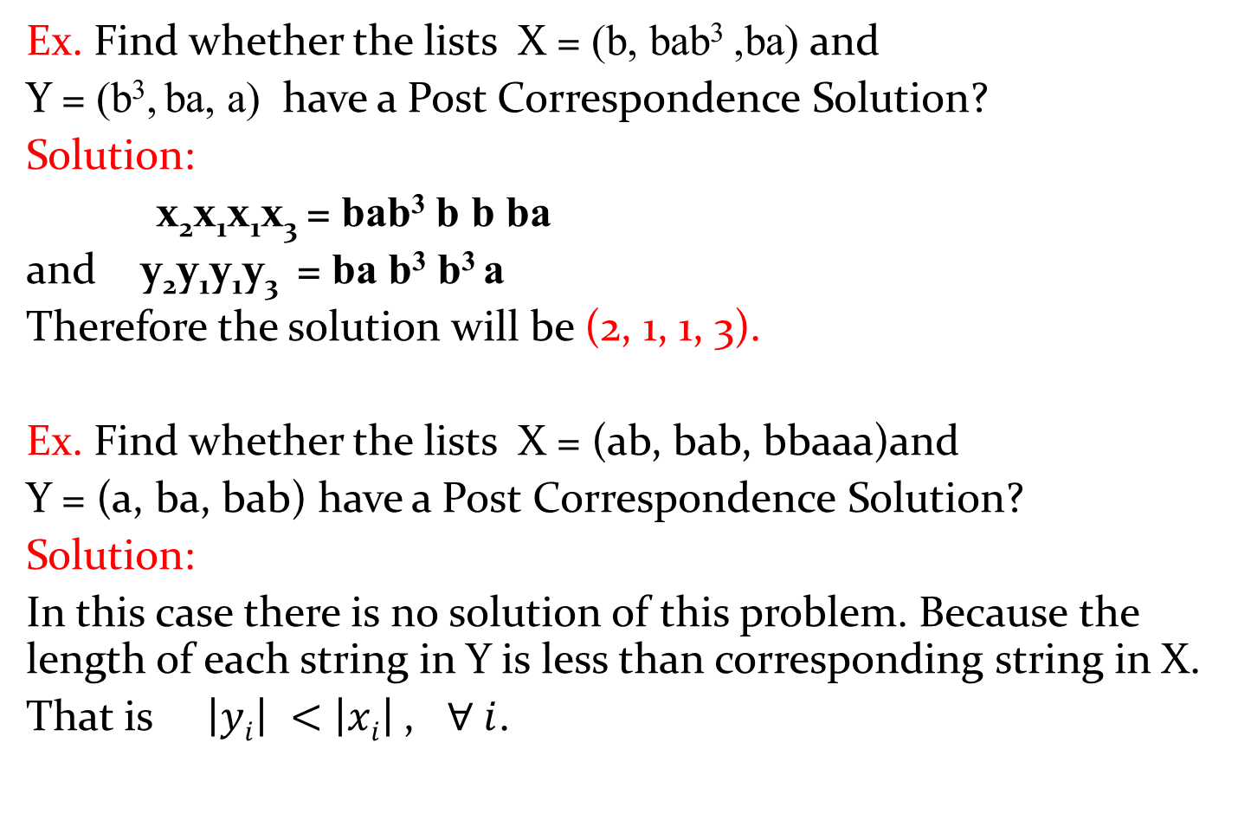
Ex. Find whether the lists X = (b, bab³ ,ba) and
Y = (b³, ba, a) have a Post Correspondence Solution?
Solution:
x₂x₁x₁x₃ = bab³ b b ba
and y₂y₁y₁y₃ = ba b³ b³ a
Therefore the solution will be (2, 1, 1, 3).
Ex. Find whether the lists X = (ab, bab, bbaaa)and
Y = (a, ba, bab) have a Post Correspondence Solution?
Solution:
In this case there is no solution of this problem. Because the length of each string in Y is less than corresponding string in X.
That is $\left|yi\right| <$ $\left|xi\right|$, $∀ i$.

Slide 65
Modified Post correspondence problem (MPCP)
The modified PCP problem over an alphabet ∑ is stated as follows:−
Given the following two lists, X and Y of non-empty strings over ∑,
X = (x₁, x₂, x₃,………, x_{n})
Y = (y₁, y₂, y₃,………, y_{n})
We can say that there is a Modified Post Correspondence Solution, if for some (i₁,i₂,………… i_{k}), where 1 ≤ i_{j} ≤ n, the condition x₁ x_{i1} x_{i2} …….x_{ik} = y₁ y_{i1} y_{i2} …….y_{ik} satisfies.

Slide 66
Universal Turing machine(UTM)
A universal Turing machine (UTM) behaves like a general purpose computer. Instead of finite size memory in computer, UTM uses infinite tape.
UTM is a specified TM that can simulate the behavior any TM.
UTM is a Turing machine that accepts universal language.
Universal language is defined as:-
UL= { <M,w> ! M is a Turing machine that accepts input string w.}
Desciption of TM
UTM
Accept,
Reject,
Goes into infinite loop
w

Slide 67
Universal Turing machine(UTM)
Input to UTM:
Description of TM
Input string
Action of UTM:
Simulate TM
Behave like TM
UTM as Computer
TM as Program
UTM is a recognizer but not a decider.
UTM takes an encoding of a TM and the input data as its input in its tape and behaves as that TM on the input data.

Slide 68
Church-Turing Thesis
It states that if there exists an algorithm to solve a problem then there exists a Turing machine to solve that problem and vice-versa.
It states that a function on the natural numbers can be computed by an algorithm if and only if it is computable by a Turing machine.
A problem can be solved by an algorithm iff it can be solved by a Turing Machine.
Algorithm Turing machine

Slide 69
Halting Problem
Statement: Given Turing machine M and input string w, is it possible to determine whether the machine will ever halt on given input string?
In another words, the halting problem is the problem of determining, from a description of an arbitrary computer program and an input, whether the program will finish running, or continue to run forever.
Halt: the machine will stop or halt at final or non-final state after finite number steps.
No halt: Machine will never stop or halt.

Slide 70
Decidable or Undecidable Problem
A problem is said to be decidable if there exists an algorithm which can decide the problem in finite amount of time.
In this type of problems, the output of the algorithm will be yes/no i.e. the answer of decidable problems is yes or no.
A problem is said to be undecidable if there does not exist an algorithm which can decide the problem in finite amount of time.

Slide 71
Turing decidable and Turing acceptable language
A language L is said to be Turing decidable if there exists a Turing machine which can accepts all strings belong in to L and rejects all strings which do not belong into L.
A language L is said to be Turing acceptable if there exists a Turing machine which can accepts all strings belong in to L.

Slide 72
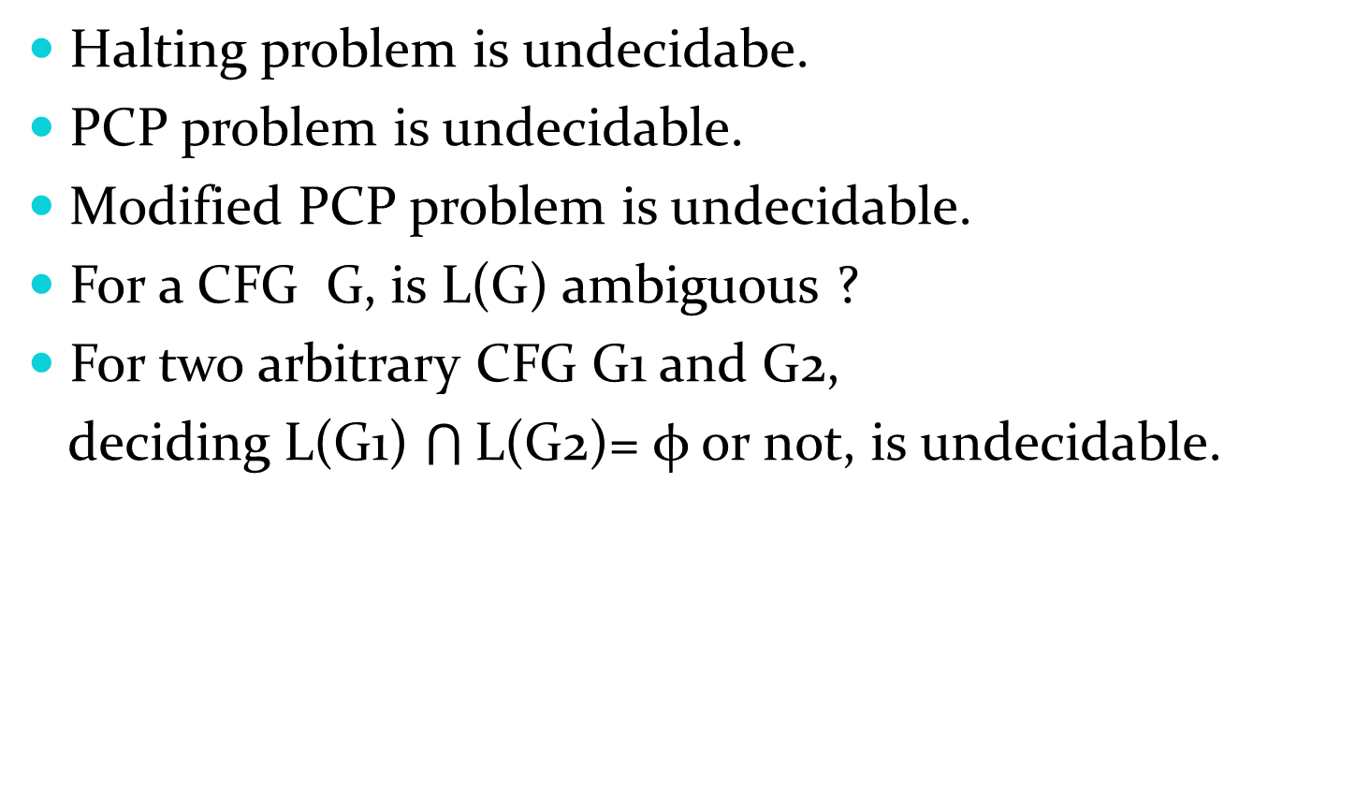
Some undecidable problems
Halting problem is undecidabe.
PCP problem is undecidable.
Modified PCP problem is undecidable.
For a CFG G, is L(G) ambiguous ?
For two arbitrary CFG G1 and G2,
deciding L(G1) $\bigcap{\text{L}\text{(}\text{G}\text{2)}}$= φ or not, is undecidable.

Slide 73
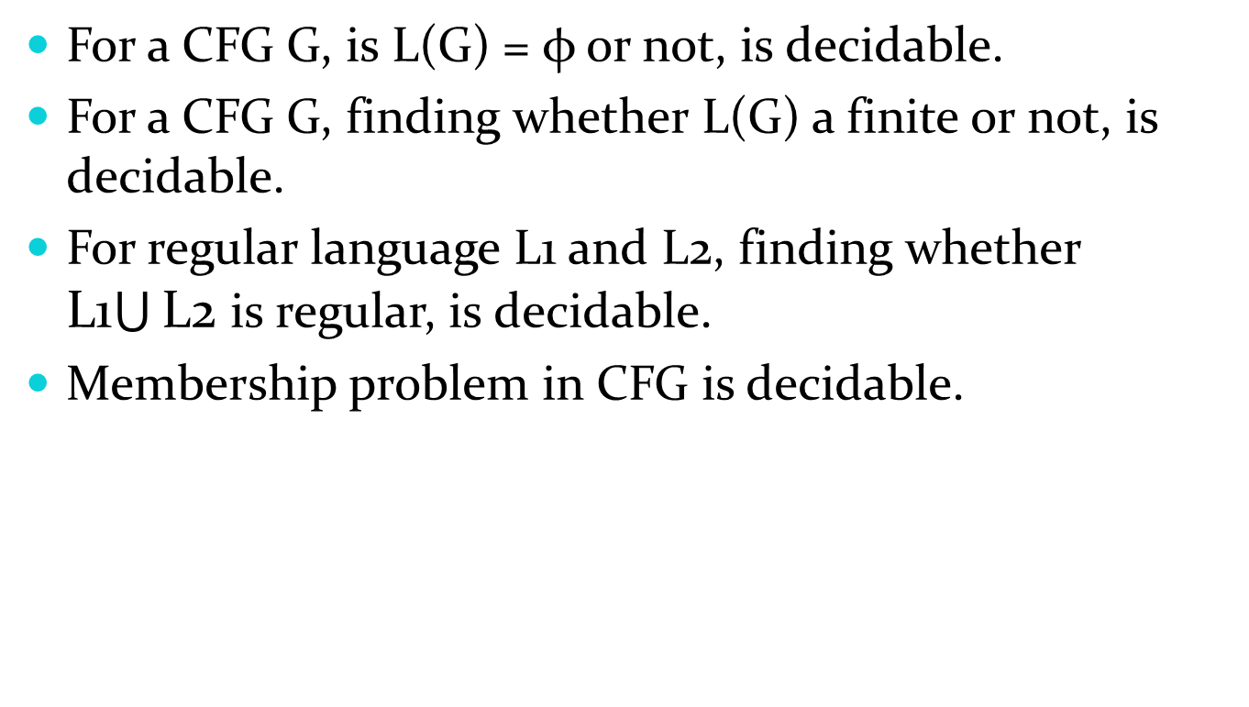
Some decidable problems
For a CFG G, is L(G) = φ or not, is decidable.
For a CFG G, finding whether L(G) a finite or not, is decidable.
For regular language L1 and L2, finding whether L1$\bigcup{\text{L}\text{2}}$ is regular, is decidable.
Membership problem in CFG is decidable.

